Slide 1
Punnya Task Management System
Windows-Native Background Telemetry & Collaborative Task Management for Technical & Content Teams
Notes:
Welcome team. Today I am presenting our custom-built desktop platform, the Punnya Task Management System, designed specifically to coordinate our technical and content creation workflows.
By focusing on native Windows engineering, we are launching an environment that eliminates manual timesheets completely, using a smart, background-running event-driven telemetry engine. This proposal is specifically structured to align with our NGO's lean operating goals: it is highly efficient, has zero software licensing overhead, and can be developed on-site in five weeks.

Slide 2
Background Activity Telemetry Maps Seamlessly to Active Projects
Lightweight Task Management
• Focused Task Boards: Custom-tailored cards for Video Editors, Newsletter Copywriters, Graphic Designers, Web Developers, and Database Administrators.
• Integrated Deliverable Control: A dedicated input field directly inside the task card allowing employees to attach PR links, design files, or ZIP deliverables before marking a task complete.
• Transparent Progress: Staff maintain complete ownership over task progression, with basic states (Assigned, In Progress, Completed) matching open technical tickets.
Efficient Background Telemetry
• Windows Focus Telemetry: Automatically tracks the active foreground application (e.g., Adobe Premiere Pro, VS Code, MS Word, Photoshop) and maps active durations directly to assigned tasks.
• OS Session Logging: Silently captures core Windows system state changes (Logon, Lock, Logoff, Sleep, Resume) to audit precise operational boundaries without invading staff privacy.
• Zero-Waste Timesheets: Completely replaces manual logging. Timesheets are generated automatically by combining background focus duration with task deliverable submissions.
Notes:
Let's walk through our operational philosophy. In most creative and technical organizations, manual timesheets are highly inefficient. Studies show that complex tracking platforms introduce massive administrative overhead, creating friction that slows down our developers and editors.
Our system solves this by splitting the screen into a collaborative Task Board on one side, and an automated Background Telemetry service on the other. This service automatically maps focus time to the currently selected task ID. Furthermore, we have integrated a 'Deliverable Control' directly into the employee client. This ensures that employees must drop a ZIP upload or a PR link into the task card before marking it completed. This connects work output directly to the logged time.

Slide 3
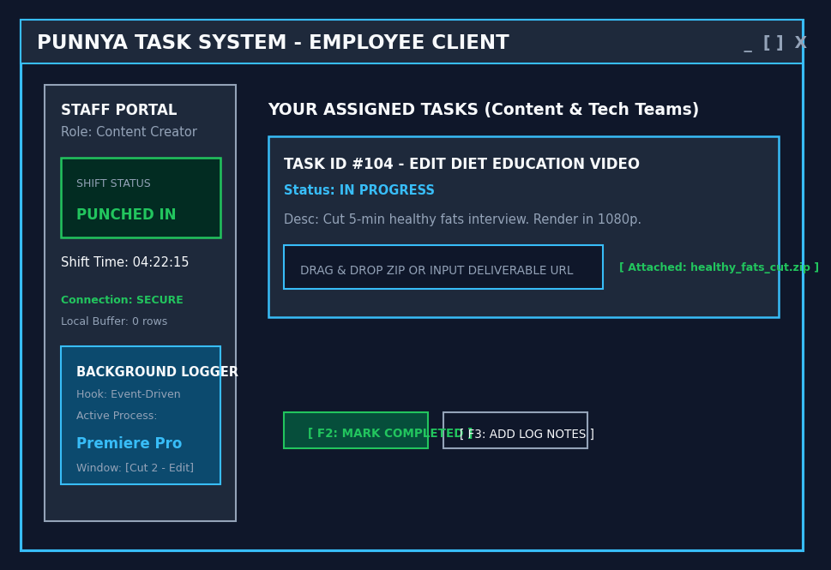
Employee Client Screen: High-Contrast Task & Logging Control
Employee Screen Feature Explanations
1. Shift Management Desk: A simple red/green Punch Status panel located in the sidebar. Staff use a single click to log shift boundaries (Punched In vs. Punched Out) securely.
2. Integrated Deliverable Control: Inside the active task card, employees are provided a dedicated upload input. They can drag and drop design assets or input pull request URLs to secure their output before completion.
3. Win32 SetWinEventHook Core: The telemetry listener utilizes event-driven Win32 hooks to monitor foreground window title focus. This triggers ONLY when the active window changes, keeping system CPU usage near 0%.
4. Offline SQLite Buffer: If internet drops occur during a shift, telemetry logs are safely cached locally inside an encrypted SQLite database and synced automatically on connection recovery.
Notes:
This slide presents our Employee Client design, built as a native Windows desktop app.
On the left sidebar, the employee sees their current shift status and elapsed session times. On the right, the active assigned task cards are displayed. To address our key gaps, we have introduced two major features on this screen:
First, we've integrated a clear file attachment block under the active task. This ensures employees have a visual place to submit their deliverables. Second, we've optimized the technical implementation of our background service. Instead of a continuous 'while(true)' loop that pollutes CPU resources, we use the event-driven Windows API 'SetWinEventHook'. This is highly efficient and consumes nearly 0% CPU, ensuring editors have maximum performance available for rendering or compiling.

Slide 4
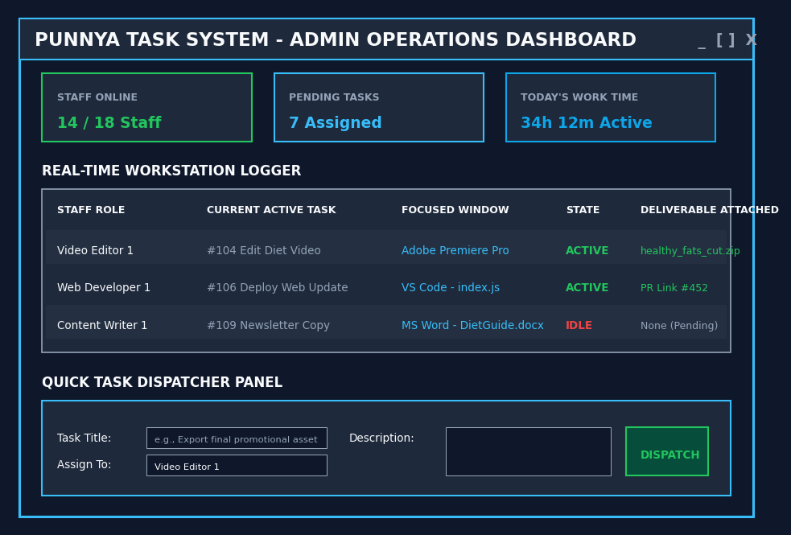
Admin Control Console: Web-Based Dispatch & Activity Radar
Admin Dashboard Feature Explanations
1. Web-Based Administration: To allow our managers to coordinate tasks on-the-go or from Mac/Windows laptops, the Admin Dashboard runs as a highly responsive Next.js/React web dashboard connected directly to Supabase.
2. Spacing-Optimized Activity Radar: Displays live workstation stats, currently active task IDs, focused software processes (e.g., Premiere, Photoshop, VS Code), and the newly integrated Deliverable Attachments column without any text overlaps.
3. Quick Task Dispatcher: Allows admins to compile a title, select a target team member from a dropdown, and dispatch it to their desktop application in real-time.
4. Automated Timesheet Exporter: Consolidates background telemetry work hours with submitted deliverables, allowing admins to export audited CSV/Excel logs for administrative reporting with one click.
Notes:
Now let's examine the Admin Management Portal. To allow maximum flexibility for our leadership team, the Admin Console is built as a cloud-hosted, responsive Web Dashboard using Next.js and Supabase.
This gives administrators full oversight on any device—mobile, Mac, or Windows—while employees execute task logs using the lightweight Windows desktop client. The workspace table has been optimized with robust padding so workstation metrics, focused windows, and deliverables do not collide. Administrators can audit the actual deliverable URLs and files from this table, ensuring that tracked work times perfectly align with our team's creative content output.

Slide 5
Technical Architecture: Secure Client-Server Link
EVENT-DRIVEN WPF CLIENT
• SetWinEventHook: Subscribes to the operating system's foreground focus changes. Highly efficient event listener utilizing near 0% CPU.
• Native C# Core: Fast Windows WPF (.NET 8) client with an ultra-lightweight framework requiring <50MB RAM.
• Accessibility Standard: Integrates Windows UI Automation (UIA) tags, full keyboard tab index controls, and high-contrast color options.
LOCAL OFFLINE BUFFER
• SQLite Buffering: Saves all workspace check-ins and telemetry records locally if a staff member loses connectivity.
• Automatic Sync Engine: An encrypted background thread periodically checks connection status and bulk-uploads stored rows to the cloud.
• OS Session Locks: Monitors when workstations lock, sleep, or shut down, immediately freezing telemetry to preserve work integrity.
SUPABASE CLOUD & WEB
• PostgreSQL Supabase DB: Stores all tasks, user directories, and tracking tables securely with built-in JWT authentication.
• Next.js Web Panel: Powers the responsive Admin console. Allows admins to dispatch tasks from web browsers on any OS (Mac, iOS, PC).
• $0 Infrastructure Cost: Leverages Supabase's free tier (up to 500MB of storage) to operate with absolute zero hosting expenses.
Notes:
Let's look at our complete system architecture, consisting of three main structural blocks.
On the left, our Event-Driven C# Windows Client uses 'SetWinEventHook' to monitor active application handles efficiently, using less than 50MB of RAM and keeping CPU load near 0%.
In the center, our Local Offline Buffer uses SQLite to keep logging fully functional during internet drops, immediately saving hours and syncing them back to the cloud on recovery. On the right, our backend Supabase database acts as a real-time coordinator. It handles our secure data storage and coordinates the React-based Web Admin Console. Best of all, because this architecture easily fits within free tiers, the infrastructure operating cost for our organization is exactly zero.

Slide 6
Structured Five-Week Timeline Guides the App to Production
WEEK 1
Database Setup
Stand up PostgreSQL schema on Supabase. Set up employee tables, task schemas, and secure authentication directories.
WEEK 2
UI Development
Develop WPF Client layouts for employees and responsive React Web Admin pages with integrated Deliverable Attachments.
WEEK 3
Win32 Hooks
Integrate active application listeners using 'SetWinEventHook' for CPU efficiency and code system sleep event listeners.
WEEK 4
Local Caching
Build the local SQLite buffer transaction database and connect background sync routines with cloud endpoints.
WEEK 5
QA & Launch
Run structured User Acceptance Testing (UAT) with creative staff and deploy optimized MSI installers office-wide.
Notes:
Finally, here is our 5-week software development and implementation roadmap.
We begin in Week 1 by establishing our secure data schemas on Supabase. In Week 2, we concurrently develop the WPF Employee window and our Web Admin dashboard, integrating our new file-upload controls. Week 3 is dedicated to Win32 programming, where we implement efficient event-driven hooks. Week 4 focuses on local SQLite buffering and sync. Finally, in Week 5, we perform User Acceptance Testing with our design and technical staff and deploy clean MSI installer packages across all office machines. This clear, actionable pipeline allows us to launch a production-ready suite on time and under budget.

